Slide 1
Progress, Reminders, and Consultant Team (PRACT)
Team Name: Set
Emily Ngo, Tobey Tan, Zijin Liu
ITWS 2110 Web Systems Development

Slide 2
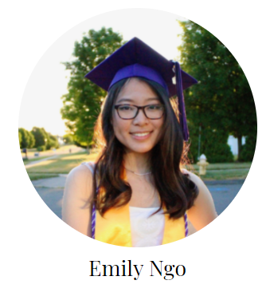
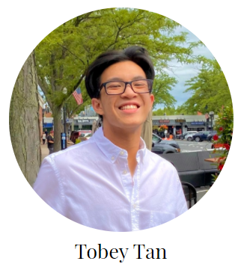
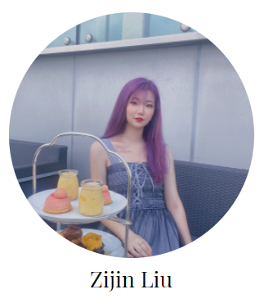
Meet our Team

Slide 3
Let us introduce a concept to you.

Slide 4
accountability.
the fact or condition of being accountable; responsibility
As defined by the Oxford Dictionary

Slide 5
Why is this important?
Establish high-performing teams
Less miscommunications
Create a better work environment & promote productivity

Slide 6
Let’s generalize the idea of accountability for a bit → Where can this be applied?

Slide 7
Possible Situations
Students trying to budget time with busy schedules
Elders remembering to follow through with daily tasks
Children and teenagers need their progress to be monitored
Employees organizing their schedule at the workplace
Project members checking up on each other’s work
& many more!

Slide 8
You’ve all witnessed at least one of these situations before.

Slide 9
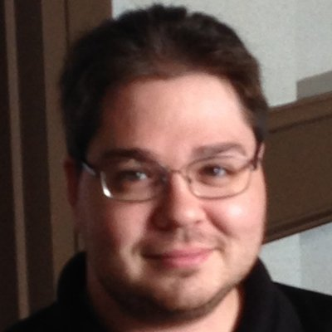
Take, for instance, your Web Systems Term Project Groups.
Google Image Result for Https://Faculty.rpi.edu/Sites/Default/Files/8l13Z1CX_400x400.Jpg, Google, www.google.com/imgres?img

Slide 10

Or how much you enjoy coming to this school
“Suffer- RPI SIS Man Sticker by Caesar.” Redbubble, www.redbubble.com/i/sticker/Suffer-RPI-SIS-Man-by-caessar/37555968.EJUG5.

Slide 11
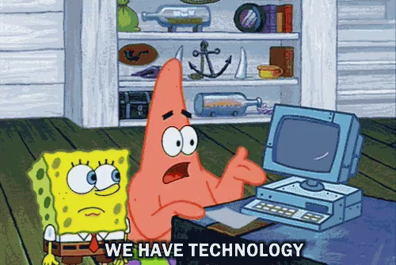
LUCKILY, WE HAVE A SOLUTION.
LMac4U. “Spongebob Technology GIF - Spongebob Technology Patrick - Discover & Share GIFs.” Tenor, Tenor, 14 June 2016, tenor.com/view/spongebob-technology-patrick-hung-gif-5567497.
Notes:
https://www.google.com/url?sa=i&url=https%3A%2F%2Ftenor.com%2Fview%2Fspongebob-technology-patrick-hung-gif-5567497&psig=AOvVaw2E6O2LLltfRn_HKVI8tnaa&ust=1631942669398000&source=images&cd=vfe&ved=0CAsQjRxqFwoTCJj6r6qihfMCFQAAAAAdAAAAABAJ

Slide 12
Progress, Reminders, And Consultant Team (or PRACT for short!)

Slide 13
Your PRACTical and
good-PRACTice solution.

Slide 14
What is our service?
Progress
(Daily) Reminders
Communication & Consultation
Discussing Challenges
How-tos, instruction and more information
Teams
Promoting good work practices & accountability

Slide 15
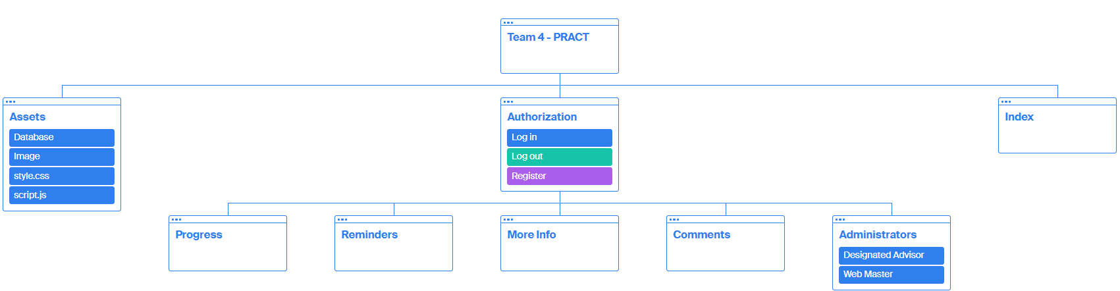
Structure

Slide 16
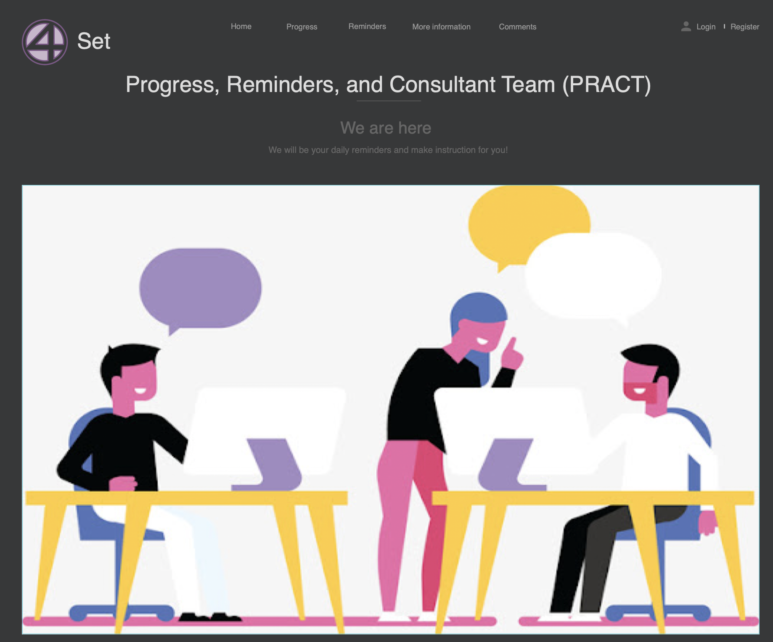

Slide 17
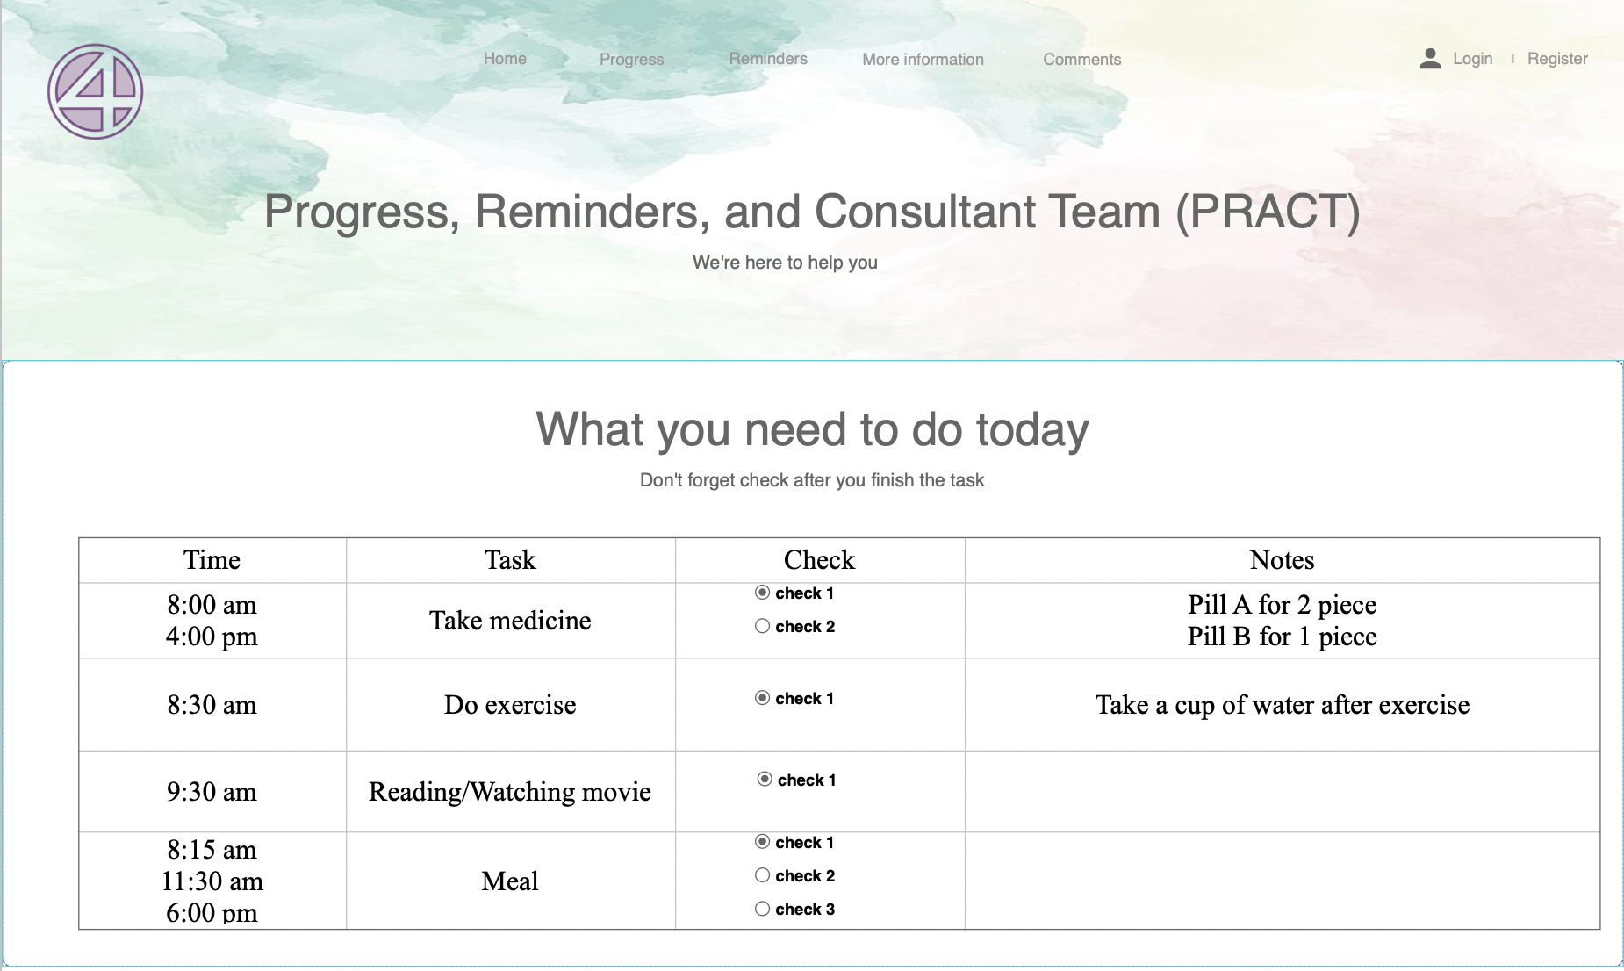

Slide 18
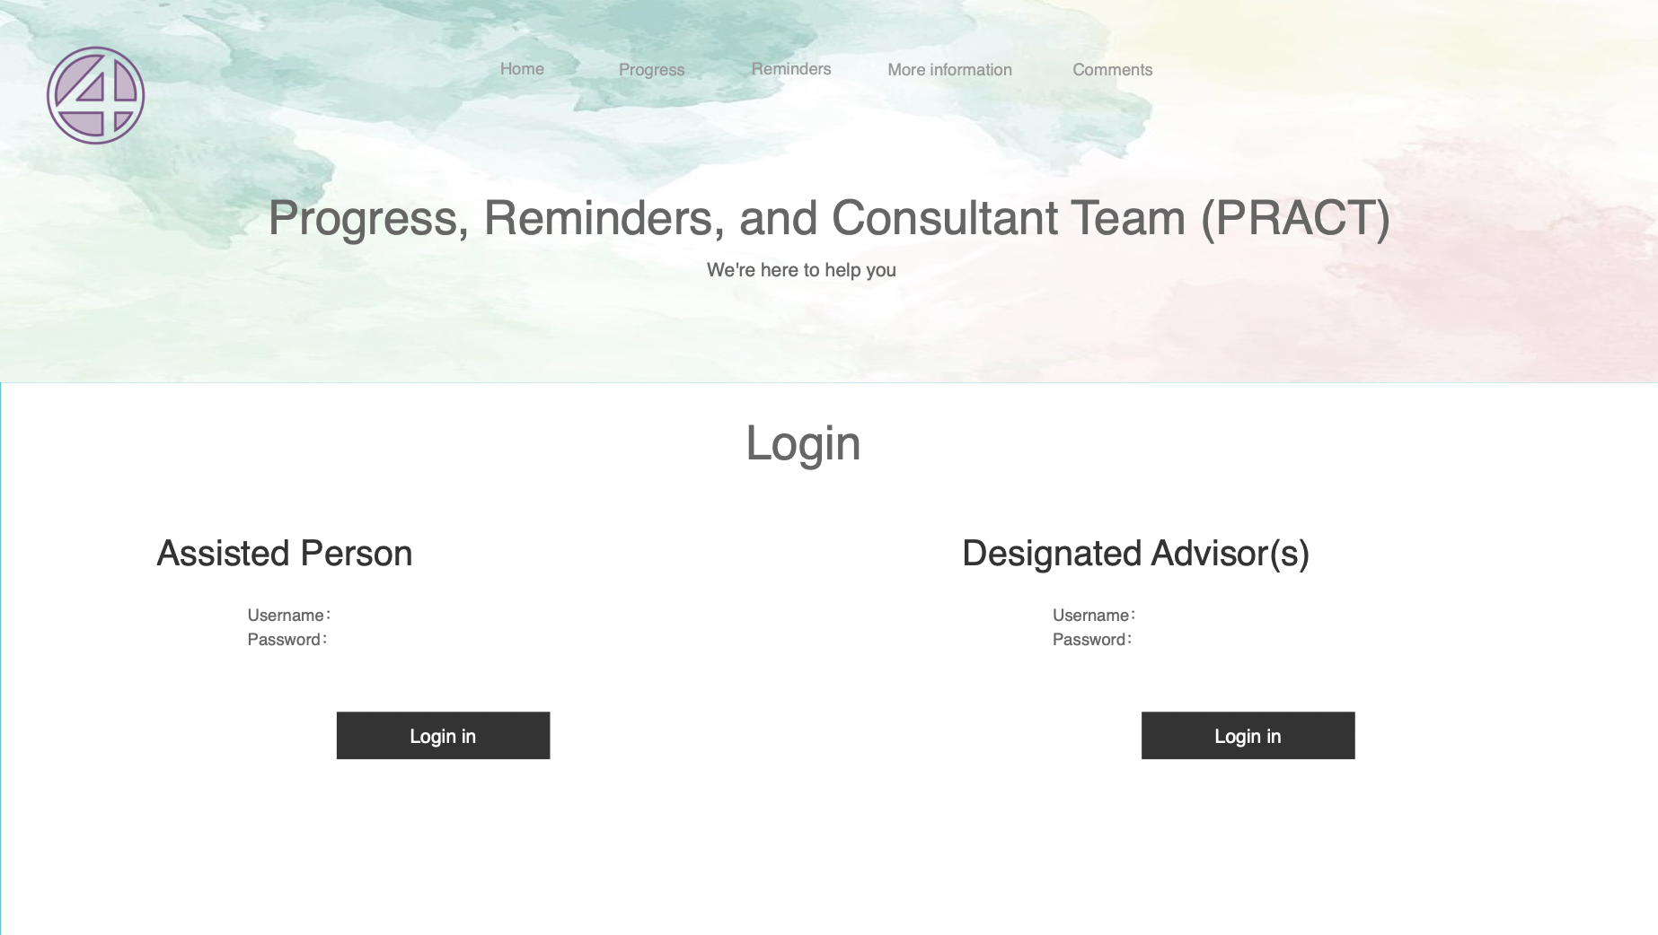

Slide 19
Timeline
Oct 15
HTML & CSS
Nov 5
PHP & MySQL
Nov 19
Functional Accounts
1
3
5
2
4
6
Midterm Presentation
Oct 22
Javascript
Nov 12
Finalize Presentation
Nov 24

Slide 20
Customer
Both General Members (GM) and Designated Advisors (DA)

Slide 21
General Members
STUDENTS: stay on top of assignments
OLDER GENERATION: Remembering important tasks
EMPLOYEES: Watch project progress
CHILDREN: Stay accountable for daily deliverables from parent/tutor

Slide 22
Designated Advisors
TEAM LEAD: Project Lead can oversee the progress for their team
ADMINISTRATOR: a higher-up can monitor the progress of other workers
PARENTS & FAMILY: can monitor and assist other family members’

Slide 23
Relevant Stakeholders
General Members
Designated Advisors (DA)
Other Family Members & Peers

Slide 24
Organization and Accountability.

Slide 25
Functional Requirements
Linking Accounts
DA & GM Posting Information onto Profiles
DA Administrative Control over GM’s viewable content
Form for DA to make appropriate changes
Prevent False Positives

Slide 26
Non-Functional Requirements
Databases
GM Privacy
Security & Encryption
Constant Updates via Unique Login

Slide 27
Conclusion
Keep. Yourself. And. Others. Accountable.
Choose PRACT.
https://vm.tiktok.com/ZMRCwR2cd/

Slide 28
Thanks for Listening

Slide 29
Any Questions?

